Slide 1
Writing a Manuscript
Matt Fury

Slide 2
Manuscript Preparation
Find a journal – Does your content fit? Find your lane.
  Formatting
  Guidelines
  Style
Read research
  Scientific writing
  Presentation style
  Academic rigor
Create your own process…

Slide 3
General Format
Abstract
Introduction
Methods
Results
Discussion
Conclusion

Slide 4
Introduction
Brief but effective
Introduce your manuscript
Broad → Specific
Establish your relevance!
  Why is this important?
  Why should this be published?

Slide 5
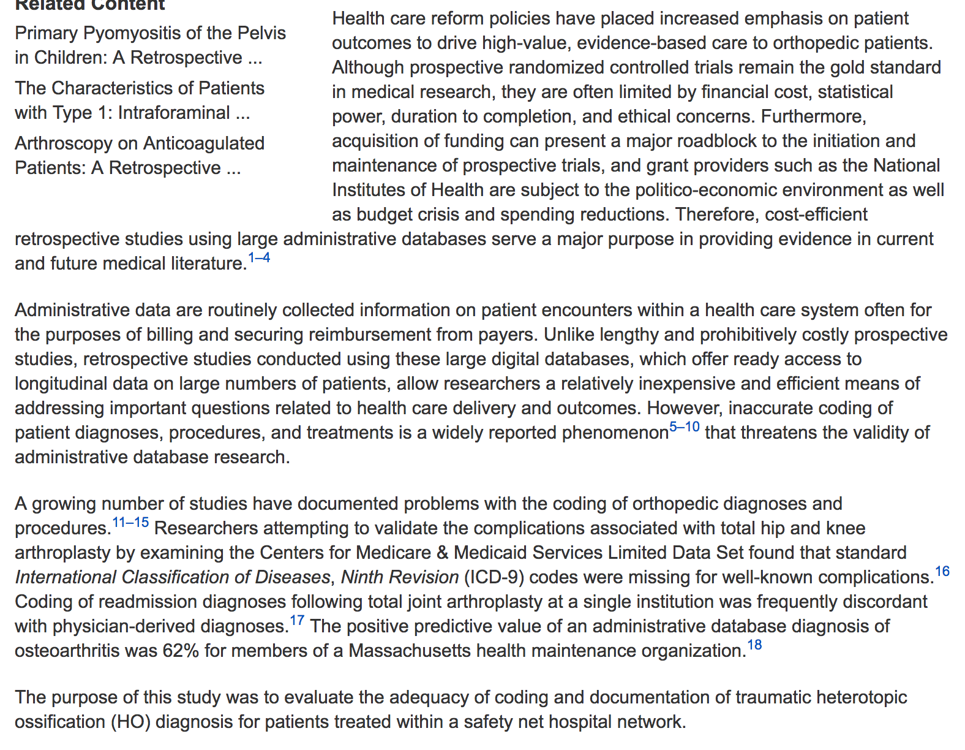

Slide 6
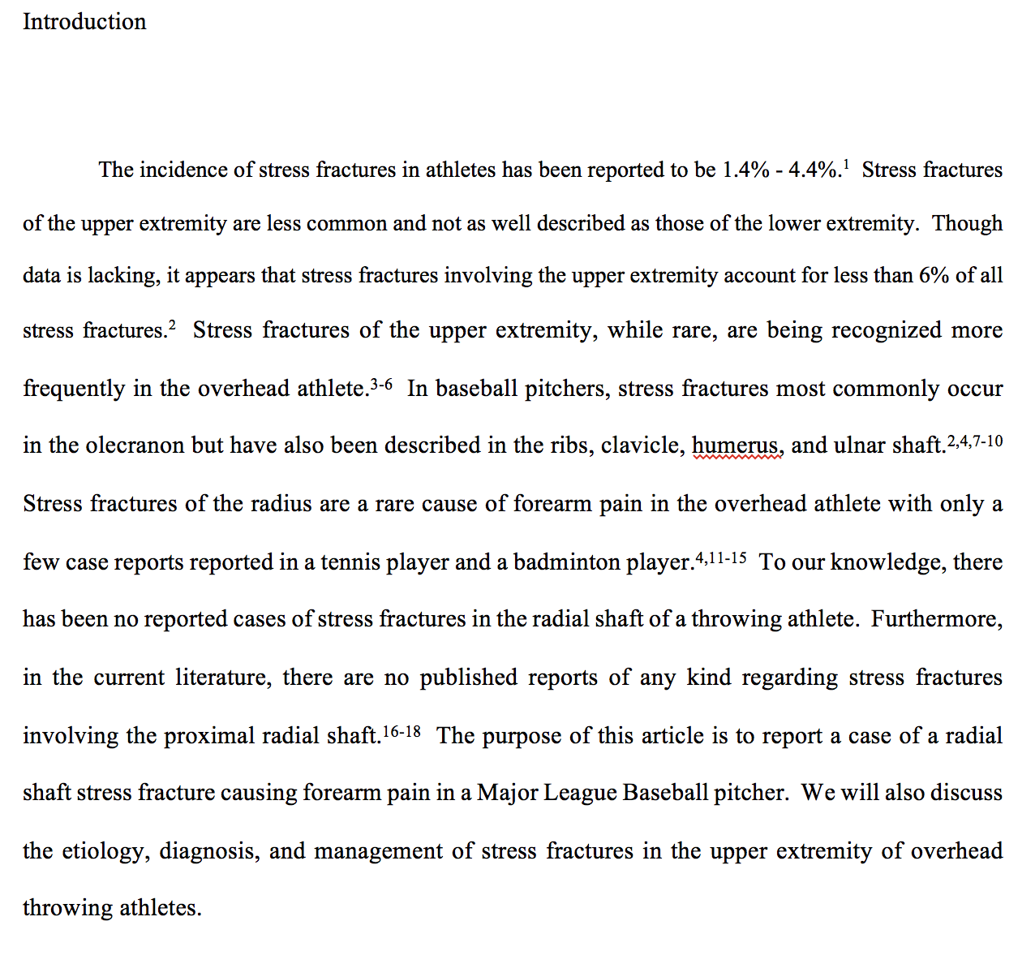

Slide 7
Methods
Concise but thorough
Explain
  Inclusion and exclusion criteria
  Surgical technique, intervention protocol
  Primary and secondary outcomes
Walk the reader through your study
Notes:
If you think you should explain it, do so.

Slide 8
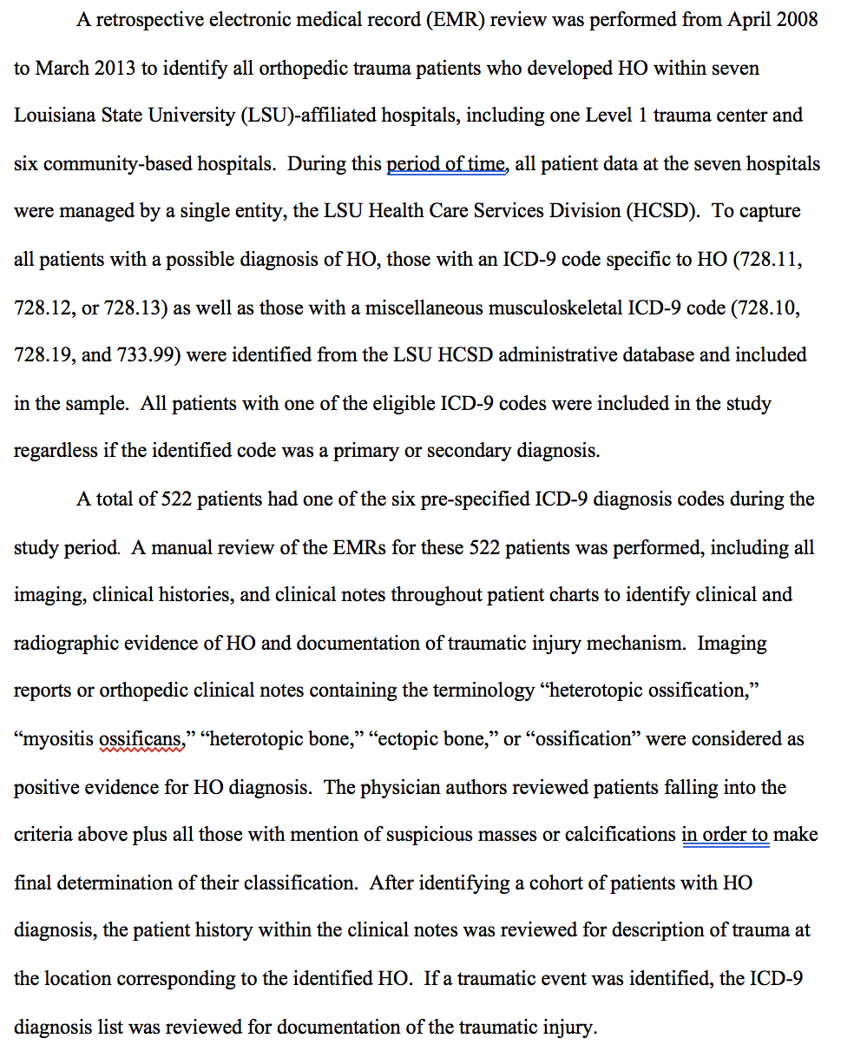

Slide 9
Results
State your findings
Charts, tables, graphics are valuable
No interpretation. Just your findings

Slide 10
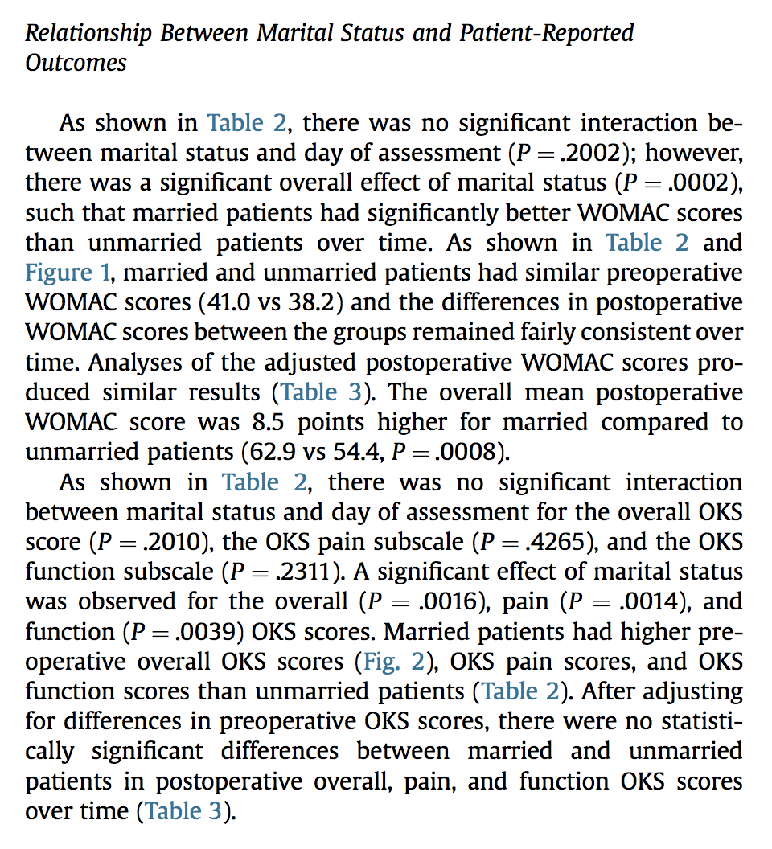

Slide 11
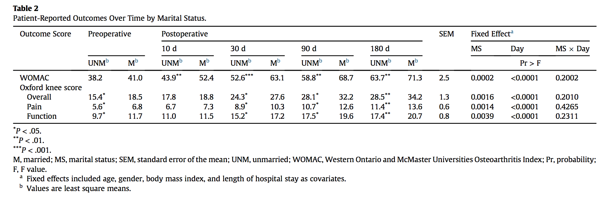

Slide 12
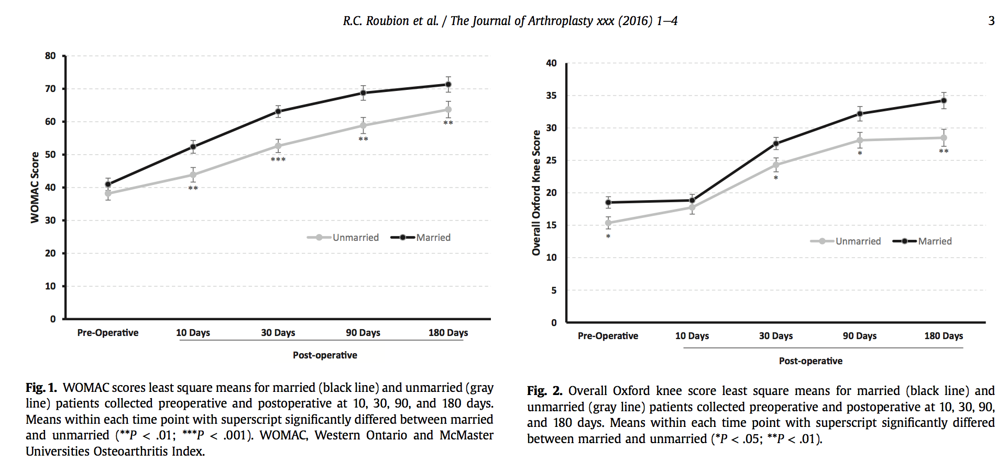

Slide 13
Discussion
Interpret your results
Establish the relevance of your findings
  Where is the clinical impact?
What were the strengths of your study? Why was it novel?
What were the limitations?
Do your findings support/contradict previous findings?
  Literature review
Where should further research go?

Slide 14
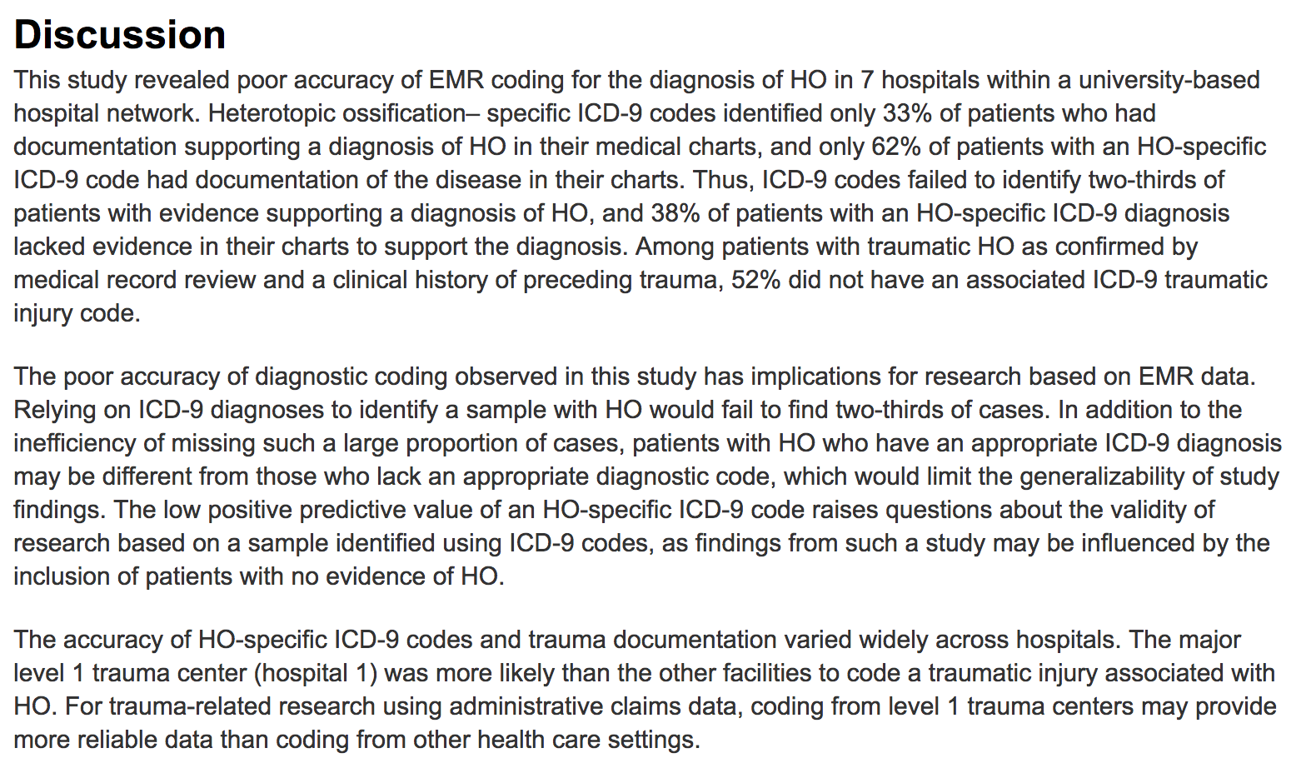

Slide 15


Slide 16
Conclusion
What should the reader take from your article?
Guide what people remember.

Slide 17
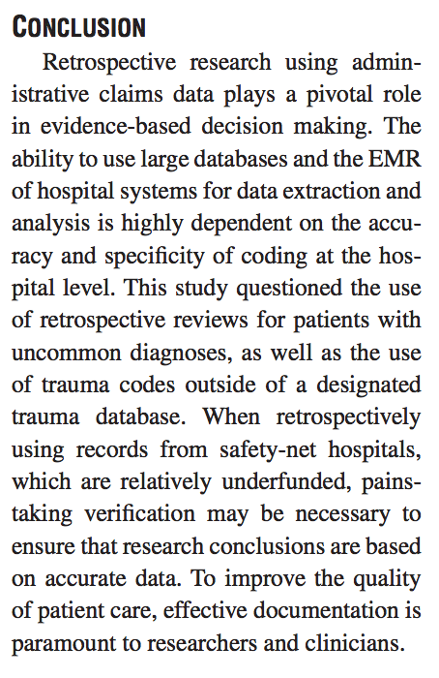

Slide 18
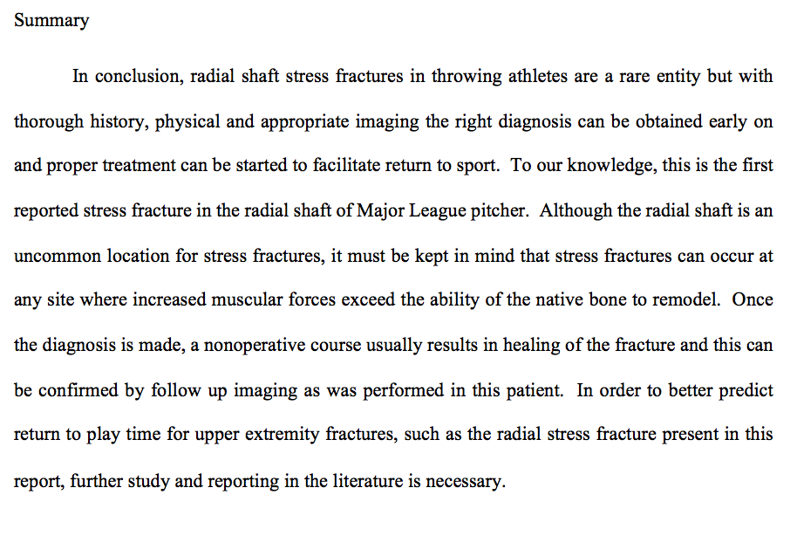

Slide 19
General Tips
Write, rewrite, rewrite again
  No confusion, no questions
Utilize reference programs through school (Refworks)
Be direct and concise. Every word contributes.
Read!

Slide 20
Open vs Arthroscopic Treatment of Acute Septic Arthritis of the Native Knee

Slide 21
Mastering the Sentence
Lorelei Lingard

